Slide 1
Making the Familiar Unfamiliar
Development of a Curriculum for Educational Training
Rainer Hawlik, Gerhard Krottenauer, and Martina Sturm
University College of Teacher Education, Vienna
Notes:
1

Slide 2
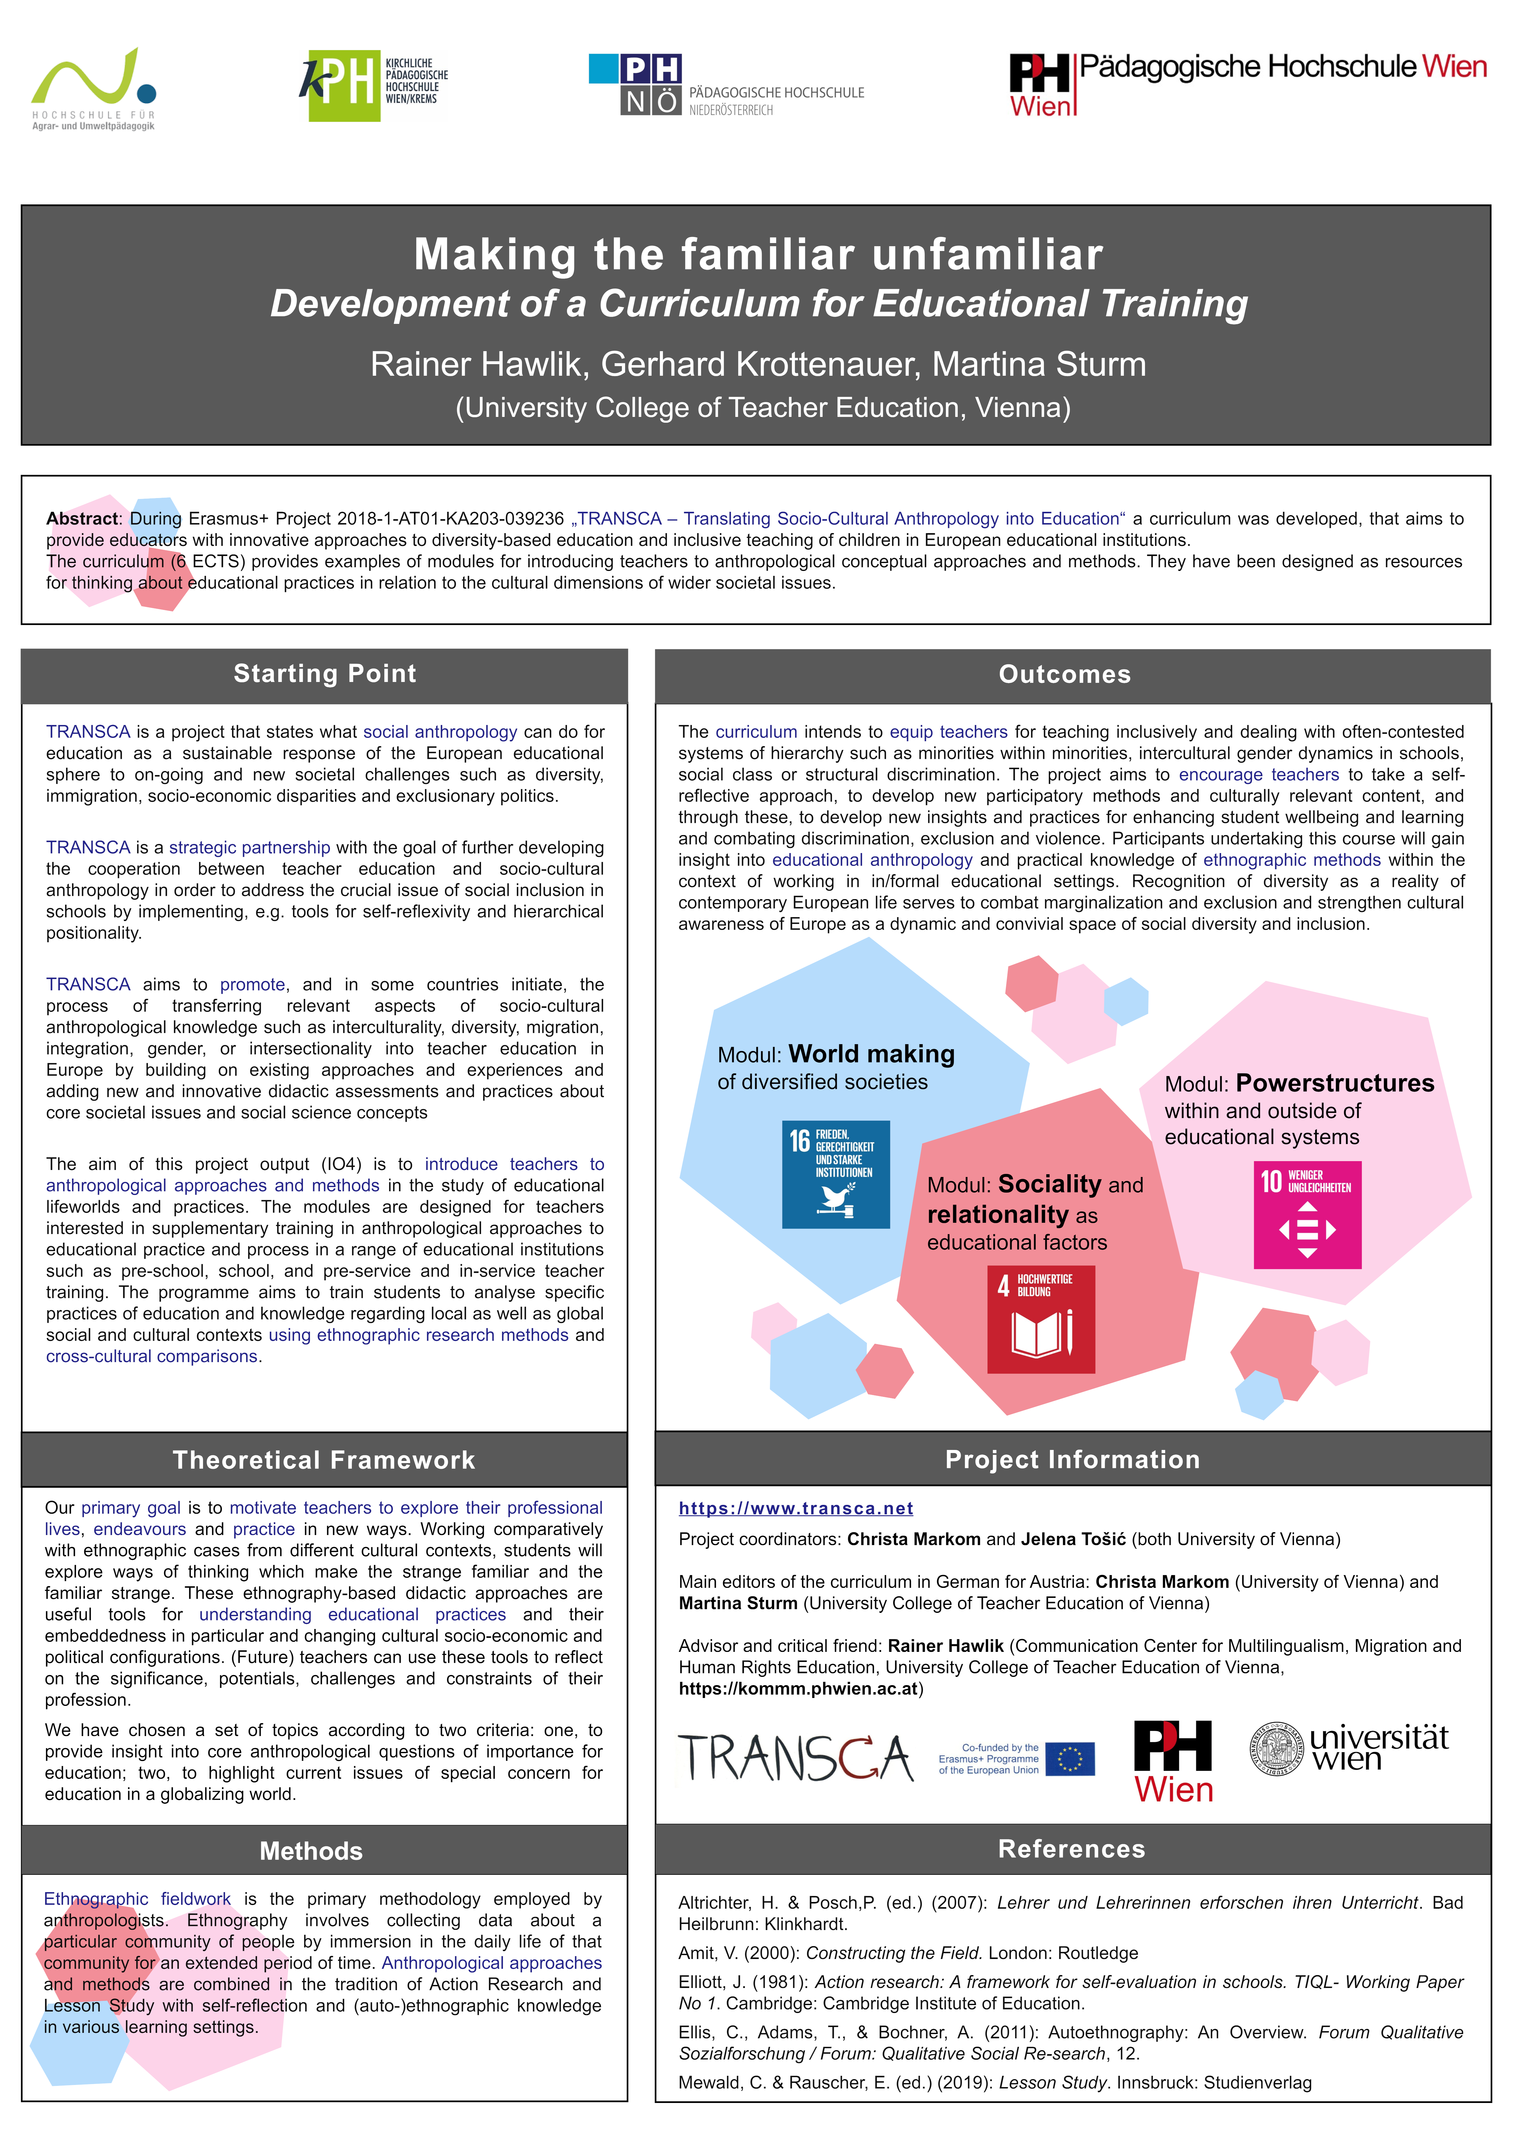
Notes:
2

Slide 3
Abstract
During Erasmus+ Project 2018-1-AT01-KA203-039236 „TRANSCA – Translating Socio-Cultural Anthropology into Education“ a curriculum was developed, that aims to provide educators with innovative approaches to diversity-based education and inclusive teaching of children in European educational institutions.
The curriculum (6 ECTS) provides examples of modules for introducing teachers to anthropological conceptual approaches and methods. They have been designed as resources for thinking about educational practices in relation to the cultural dimensions of wider societal issues.
Notes:
3

Slide 4
Starting Point
TRANSCA is a project that states what social anthropology can do for education as a sustainable response of the European educational sphere to on-going and new societal challenges such as diversity, immigration, socio-economic disparities and exclusionary politics.
TRANSCA is a strategic partnership with the goal of further developing the cooperation between teacher education and socio-cultural anthropology in order to address the crucial issue of social inclusion in schools by implementing, e.g. tools for self-reflexivity and hierarchical positionality.
TRANSCA aims to promote, and in some countries initiate, the process of transferring relevant aspects of socio-cultural anthropological knowledge such as interculturality, diversity, migration, integration, gender, or intersectionality into teacher education in Europe by building on existing approaches and experiences and adding new and innovative didactic assessments and practices about core societal issues and social science concepts
The aim of this project output (IO4) is to introduce teachers to anthropological approaches and methods in the study of educational lifeworlds and practices. The modules are designed for teachers interested in supplementary training in anthropological approaches to educational practice and process in a range of educational institutions such as pre-school, school, and pre-service and in-service teacher training. The programme aims to train students to analyse specific practices of education and knowledge regarding local as well as global social and cultural contexts using ethnographic research methods and cross-cultural comparisons.
Notes:
4

Slide 5
Theoretical Framework
Our primary goal is to motivate teachers to explore their professional lives, endeavours and practice in new ways. Working comparatively with ethnographic cases from different cultural contexts, students will explore ways of thinking which make the strange familiar and the familiar strange. These ethnography-based didactic approaches are useful tools for understanding educational practices and their embeddedness in particular and changing cultural socio-economic and political configurations. (Future) teachers can use these tools to reflect on the significance, potentials, challenges and constraints of their profession.
We have chosen a set of topics according to two criteria: one, to provide insight into core anthropological questions of importance for education; two, to highlight current issues of special concern for education in a globalizing world.
Notes:
5

Slide 6
Methods
Ethnographic fieldwork is the primary methodology employed by anthropologists. Ethnography involves collecting data about a particular community of people by immersion in the daily life of that community for an extended period of time. Anthropological approaches and methods are combined in the tradition of Action Research and Lesson Study with self-reflection and (auto-)ethnographic knowledge in various learning settings.
Notes:
6

Slide 7
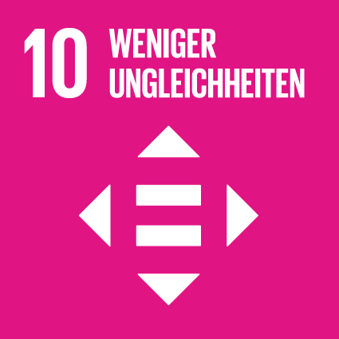
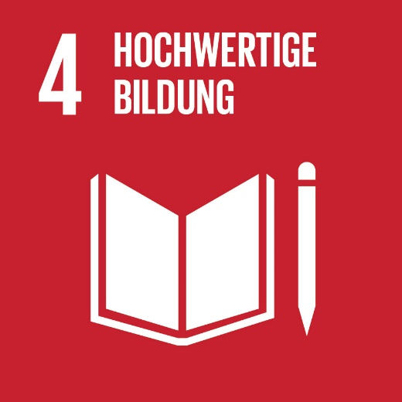
Outcomes
The curriculum intends to equip teachers for teaching inclusively and dealing with often-contested systems of hierarchy such as minorities within minorities, intercultural gender dynamics in schools, social class or structural discrimination. The project aims to encourage teachers to take a self-reflective approach, to develop new participatory methods and culturally relevant content, and through these, to develop new insights and practices for enhancing student wellbeing and learning and combating discrimination, exclusion and violence. Participants undertaking this course will gain insight into educational anthropology and practical knowledge of ethnographic methods within the context of working in in/formal educational settings. Recognition of diversity as a reality of contemporary European life serves to combat marginalization and exclusion and strengthen cultural awareness of Europe as a dynamic and convivial space of social diversity and inclusion.
Module: World making of diversified societies
Module: Powerstructures within and outside of educational systems
Module: Sociality and relationality as educational factors
Notes:
7

Slide 8
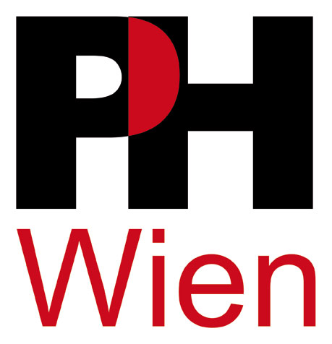
Project Information
https://www.transca.net
Project coordinators:
Christa Markom (University of Vienna) and Jelena Tošić
Main editors of the curriculum in German for Austria:
Christa Markom (University of Vienna) and Martina Sturm (University College of Teacher Education of Vienna)
Advisor and critical friend:
Rainer Hawlik (Communication Center for Multilingualism, Migration and Human Rights Education, University College of Teacher Education of Vienna, https://kommm.phwien.ac.at)
Notes:
8

Slide 9
References
Altrichter, H. & Posch,P. (ed.) (2007): Lehrer und Lehrerinnen erforschen ihren Unterricht. Bad Heilbrunn: Klinkhardt.
Amit, V. (2000): Constructing the Field. London: Routledge
Elliott, J. (1981): Action research: A framework for self-evaluation in schools. TIQL- Working Paper No 1. Cambridge: Cambridge Institute of Education.
Ellis, C., Adams, T., & Bochner, A. (2011): Autoethnography: An Overview. Forum Qualitative Sozialforschung / Forum: Qualitative Social Re-search, 12.
Mewald, C. & Rauscher, E. (ed.) (2019): Lesson Study. Innsbruck: Studienverlag
Notes:
9

